Slide 1




PDS
Amazon RDS
Computer Vision
https://github.com/siagianp
https://www.youtube.com/@AmelOline/videos
https://github.com/amelcharolinesgn2/Cloud-Infrastructures
https://github.com/amelcharolinesgn2/ClouD-Infrastructure-SISKA-2025
https://github.com/amelcharolinesgn2/CCNA1
https://github.com/amelcharolinesgn2/CCNA2
https://github.com/amelcharolinesgn2/AWS Certificate
Notes:
Lab Session 01: AWS Compute Foundations – EC2, Networking, and Application Deployment Lab Session 02: Identity and Access Control with IAM Lab Session 03: Cloud Storage Solutions – S3, EBS, and EFS Lab Session 04: Database Services – RDS, DynamoDB, and ElastiCache Lab Session 05: Load Balancing and Auto Scaling Lab Session 06: Container Orchestration with ECS, Fargate, and EKS Lab Session 07: Serverless Computing with Lambda Lab Session 08: Monitoring, Logging, and Security Auditing Lab Session 09: Infrastructure as Code – CloudFormation, CDK, and Terraform Lab Session 10: CI/CD Pipelines – App Runner, CodePipeline, GitHub Actions, and CodeDeploy Lab Session 11: AI/ML Services – Rekognition, Comprehend, Translate, and SageMaker Lab Session 12: Hybrid Cloud Networking – VPC Peering, Transit Gateway, VPN, and Direct Connect Lab Session 13: Security and Compliance – AWS Config, GuardDuty, Security Hub, and KMS Lab Session 14: Disaster Recovery and Business Continuity – AWS Backup, Multi-Region, and Failover Lab Session 15: Migration and Modernization – DataSync, DMS, MGN, Containers, and Serverless
Lab Session 16: Cost Management and Optimization – Cost Explorer, Trusted Advisor, Budgets, and Well-Architected
https://www.youtube.com/watch?v=SOTamWNgDKc&t=19604s

Slide 2
Amazon RDS
Managed Relational Database Service

Slide 3
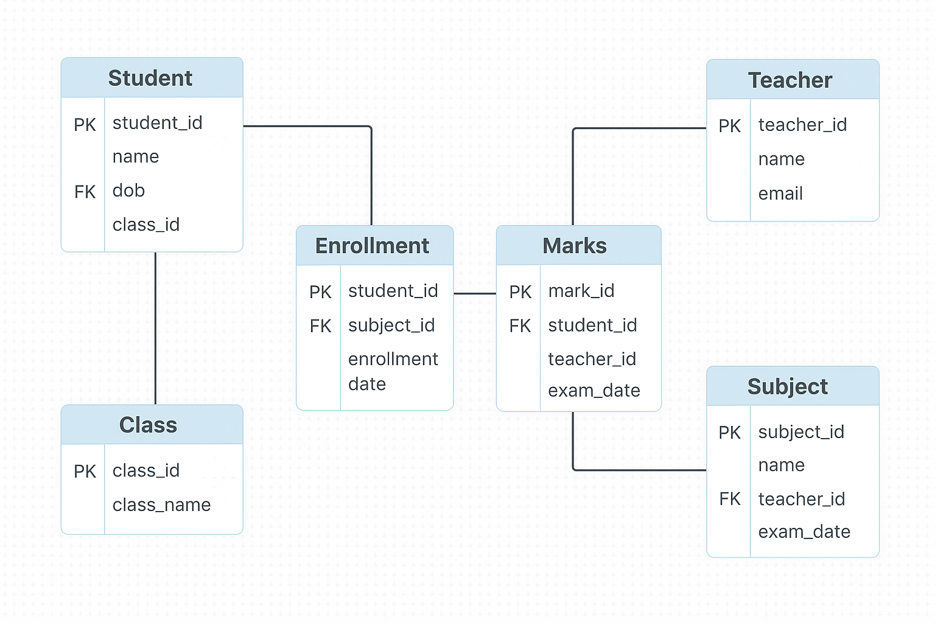
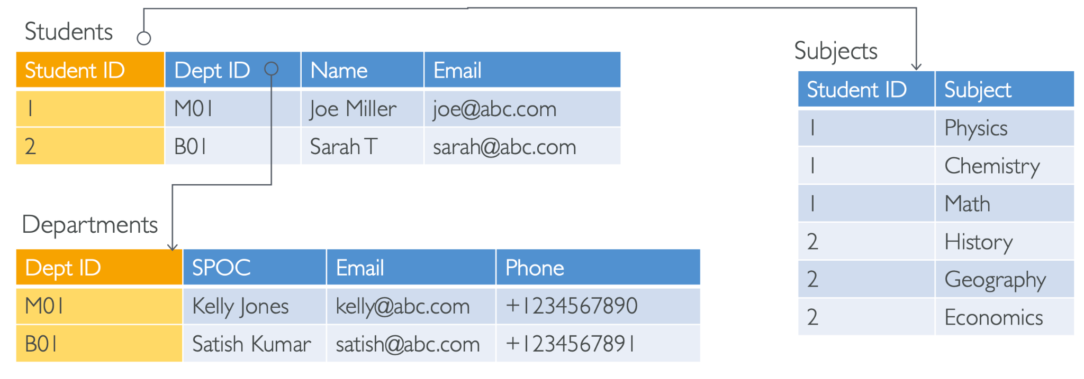
Relational Databases

Slide 4
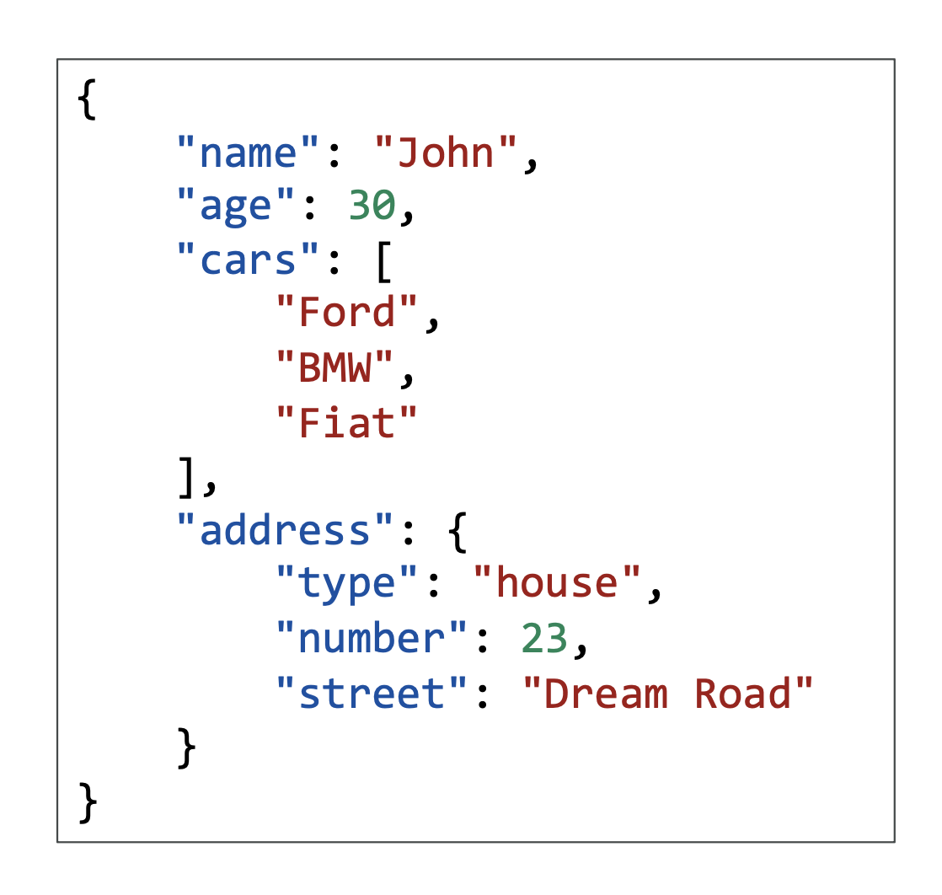
NoSQL
• NoSQL = non-SQL = non relational databases
• NoSQL databases are purpose built for specific data models and have
flexible schemas for building modern applications.

Slide 5
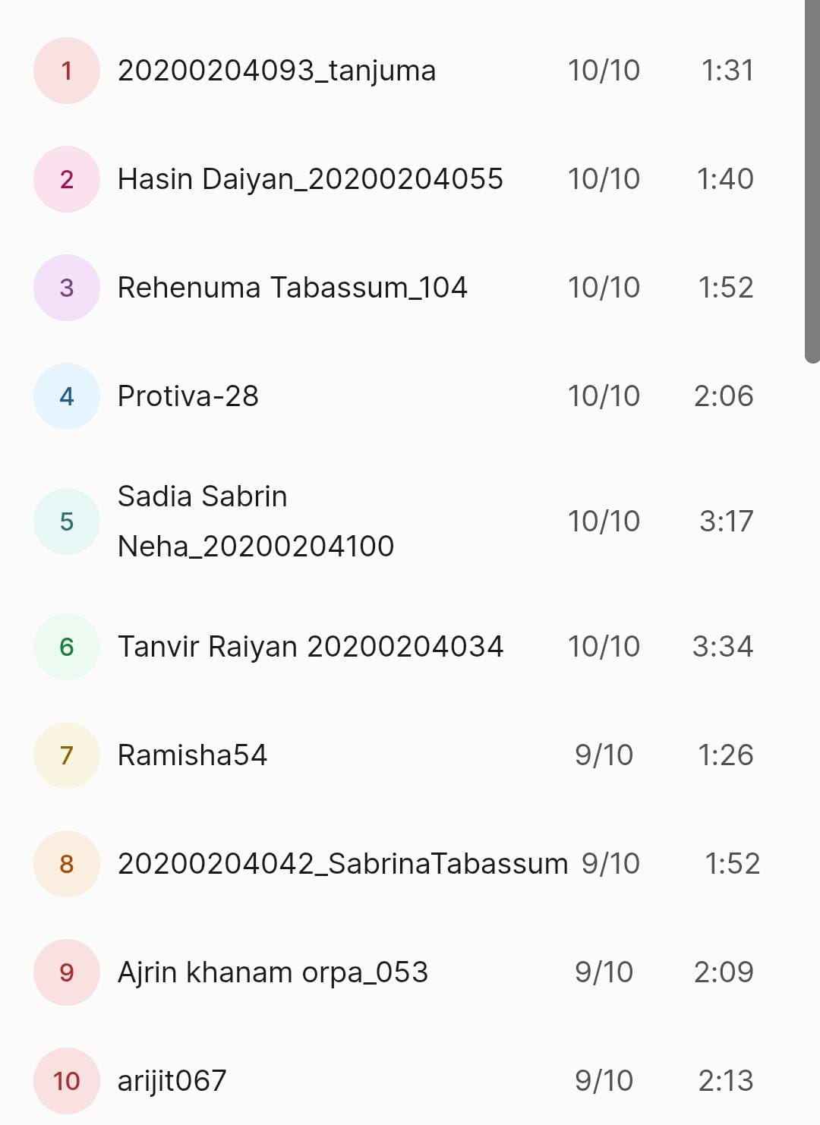
Practice
Students
SL | Username | Marks | time
Find the username with the highest marks from the table.
Find the second highest marks from the table.

Slide 6
1. Find the username with the highest marks from the table.
SELECT Username, Marks
FROM Students
WHERE Marks = (SELECT MAX(Marks) FROM Students);

Slide 7
Find the second highest marks from the table.
SELECT Name, Marks
FROM Students
WHERE Marks = (
SELECT MAX(Marks)
FROM Students
WHERE Marks < (SELECT MAX(Marks) FROM Students)
);

Slide 8
Databases & Shared Responsibility on AWS
Many databases technologies could be run on EC2,
but you must handle yourself
The resiliency,
Backup,
Patching,
High availability,
Fault tolerance,
Scaling

Slide 9
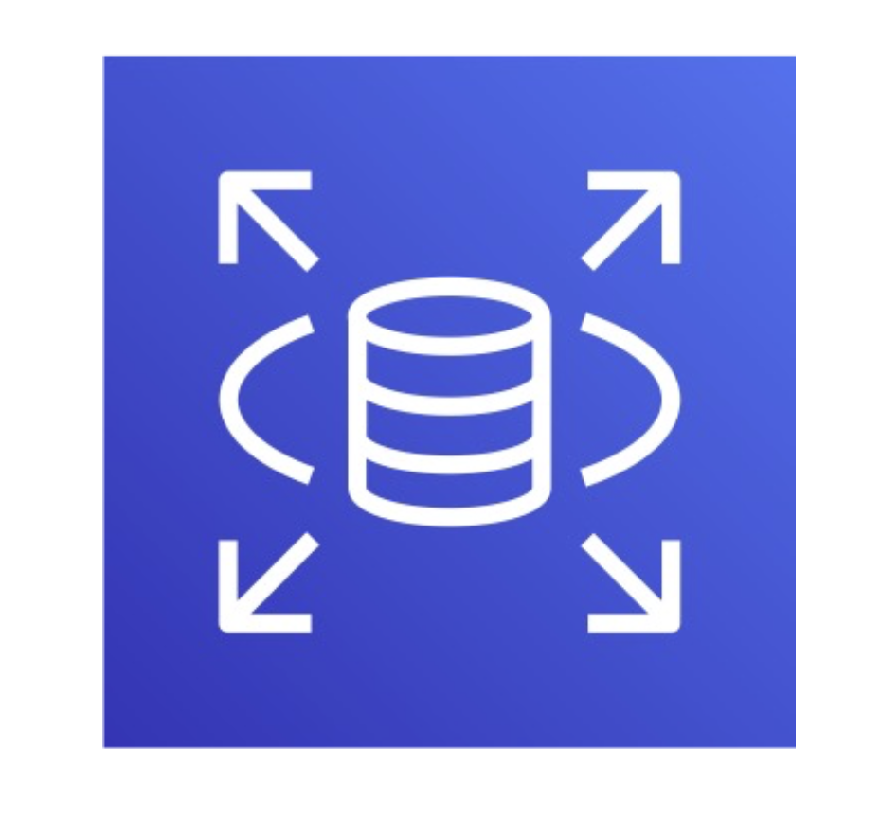
AWS RDS Overview
What is Amazon RDS?
A fully managed relational database service supporting MySQL, PostgreSQL, MariaDB, Oracle, SQL Server, and Amazon Aurora.
Handles database administration tasks (backups, patching, scaling).
Key Benefits
High availability with Multi-AZ deployments.
Automated backups and point-in-time recovery.
Scalable compute and storage.

Slide 10
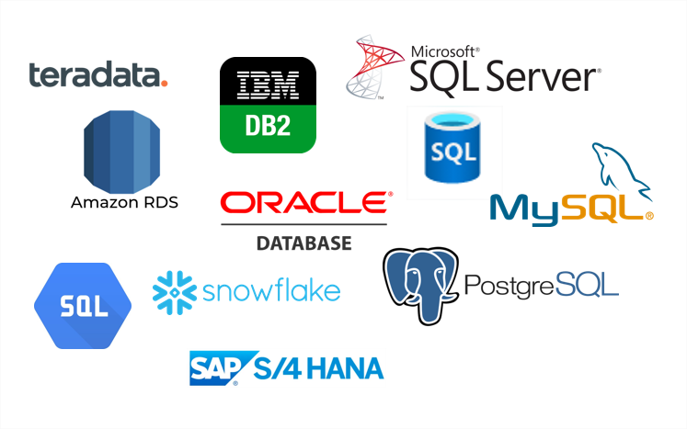
Supported Database Engines
Available Engines
MySQL: Open-source, widely used for web apps.
PostgreSQL: Advanced features, JSON support.
MariaDB: MySQL fork with enhanced performance.
Oracle: Enterprise-grade, licensed.
SQL Server: Microsoft’s relational database.
Amazon Aurora: AWS-optimized MySQL/PostgreSQL-compatible DB.

Slide 11
Key Features
1. Automated Backups
Daily backups + transaction logs (retained for up to 35 days).
Restore to any point within the retention period.
2. Multi-AZ Deployments
Synchronous replication to a standby instance in another AZ.
Automatic failover during outages.
3. Read Replicas
Asynchronous replication for read-heavy workloads (up to 15 replicas).
Available for MySQL, PostgreSQL, MariaDB, and Aurora.

Slide 12
Use Cases
1. Web Applications
Host dynamic websites (e.g., WordPress, e-commerce).
2. Enterprise Applications
Run ERPs, CRMs, or financial systems.
3. Analytics
Use read replicas for reporting without impacting production.

Slide 13
Scaling RDS
Vertical Scaling
Increase instance size (e.g., from db.t3.small to db.r5.large).
Requires downtime for some engines.
Horizontal Scaling
Add read replicas to distribute read traffic.
Storage Scaling
Automatically scales up (no downtime) for most engines.

Slide 14
Best Practices
1. Backups
Enable automated backups and test restores.
2. Monitoring
Use CloudWatch for CPU, memory, and storage metrics.
3. Cost Optimization
Use Reserved Instances for long-term workloads.
Delete unused instances.

Slide 15
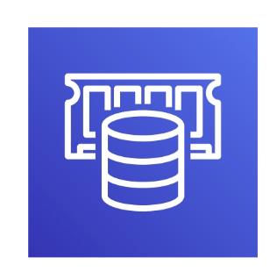
AWS ElastiCache
• The same way RDS is to get managed Relational Databases…
• ElastiCache is to get managed Redis or Memcached
• Caches are in-memory databases with high performance, low latency
• Helps reduce load off databases for read intensive workloads

Slide 16
THANK YOU
Amel charoline
Amel Online & Irene magdalena
https://github.com/siagianp
https://www.youtube.com/@AmelOline/videos
https://github.com/amelcharolinesgn2/Cloud-Infrastructures
https://github.com/amelcharolinesgn2/ClouD-Infrastructure-SISKA-2025
https://github.com/amelcharolinesgn2/CCNA1
https://github.com/amelcharolinesgn2/CCNA2
https://github.com/amelcharolinesgn2/AWS Certificate

